Slide 1
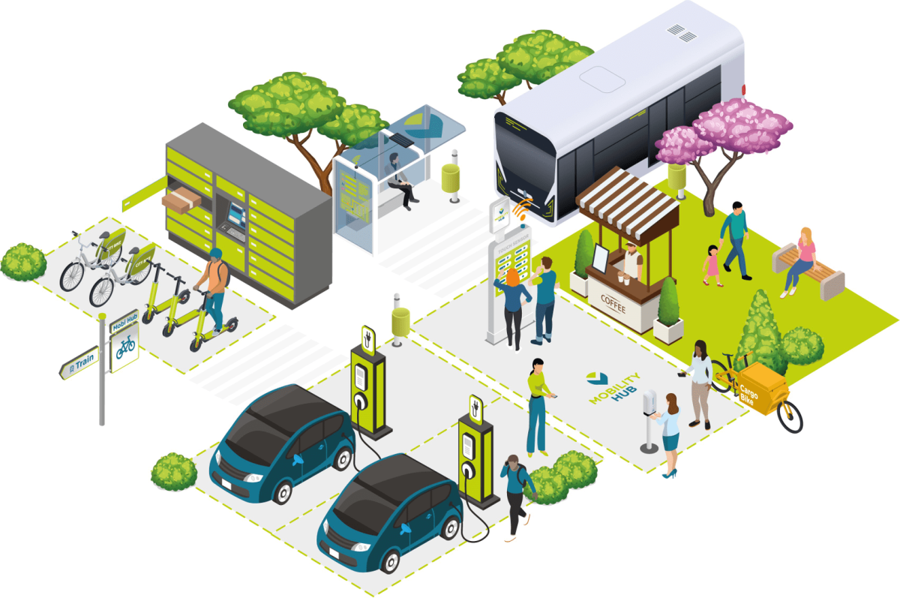

OSLO Passenger Transport Hubs:
Thematic workshop 2
Welcome!
Thursday 23rd of June 2022
Virtual workshop – Microsoft Teams
We start at 09:05am

Slide 2



Before we start…
Mute yourself during the meeting
Raise your hand before speaking. We encourage interaction!
Questions and suggestions can always be communicated via the chat.
Recorded
yes/no questions can be answered via the chat:
Yes = +1
No = - 1
Neutral = 0

Slide 3


Objective
Explanation and elaboration on discussion points of last session
Giving a summary of the first thematic workshop
Presentation of and gathering of last remarks on the revised model for this data standard

Slide 4
Objectives of today
Presentation of the final data model
Summary of the last thematic working group
Presentation and discussion of the data model
Explanation of how to consult the model, application profile and vocabulary

Slide 5
Topics
09:00 - 09:10 AM | Welcome and introduction
09:10 - 09:20 AM | Recap of last workshop
09:20 - 09:50 AM | Passenger Transport Hubs model
9:50 - 10:00 AM | Break
10:00 - 10:15 AM | Publication PURL.eu
10:15 - 10:25 AM | Registering issues
10:25 - 10:45 AM | Q&A and next steps

Slide 6

Who is who?

Slide 7
Recap of the last thematic workshop

Slide 8


Topics of the last thematic workshop
Introduction to Unified Modeling Language
Presentation of the model
Discussion points
An intro was given about the working of Unified Modeling Language
Providing a basic knowledge of UML, in order that people understand how to read the model.
The model was presented
Focused on adjustments that we’re made
Adjustment of spelling mistakes
Translation errors
Presentation of page on PURL.eu
Discussion of our views on the discussion points from the business working group.
How will we take it into account?
Which things are out of scope?
Brainstorm about possible improvements of and adjustments to the model

Slide 9
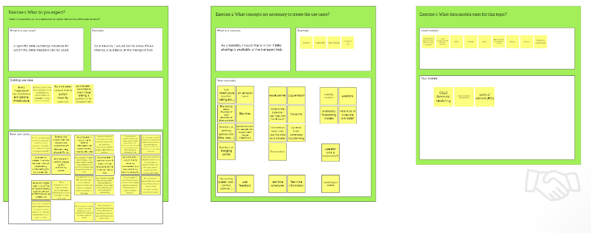
Scope of this project
Develop a semantic framework for mapping Passenger Transport Hubs and sharing data.
Develop a sustainable application profile and vocabulary for Passenger Transport Hubs.
We follow the OSLO methodology, which means:
We start from use cases
We align as much as possible with existing standards
We define cases ourselves where necessary

Slide 10

Passenger Transport Hubs model

Slide 11
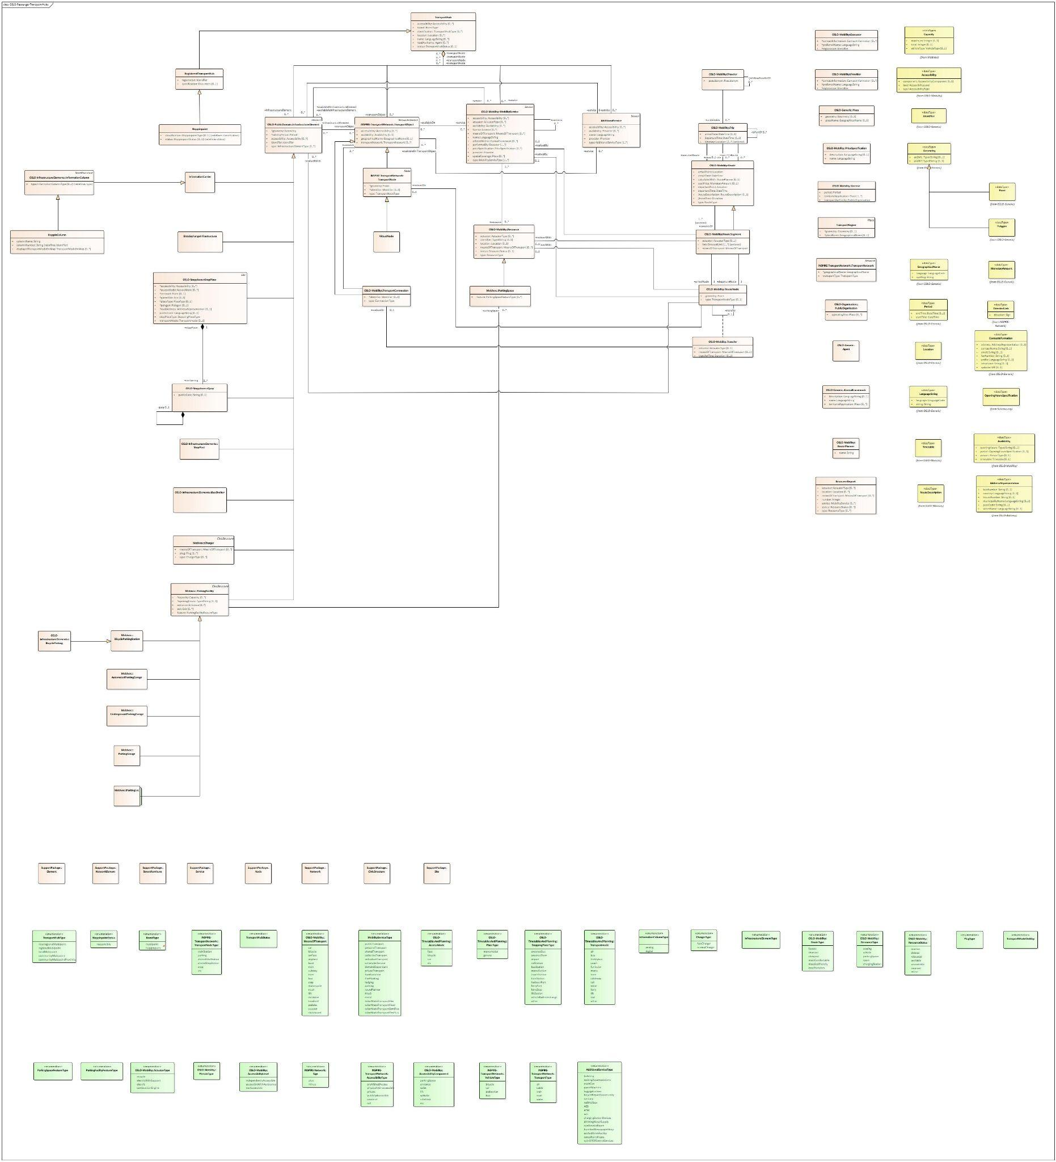
Full model
Semantic description of a Transport Hub.
Description of the role of a Transport Hub within the creation of a Traveler’s trip.

Slide 12
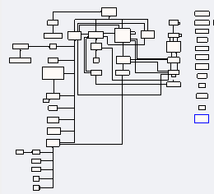
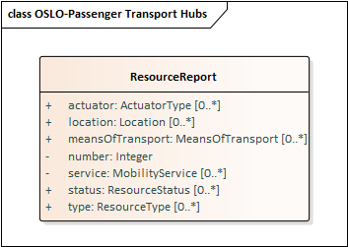
Adjustments to the model

Slide 13
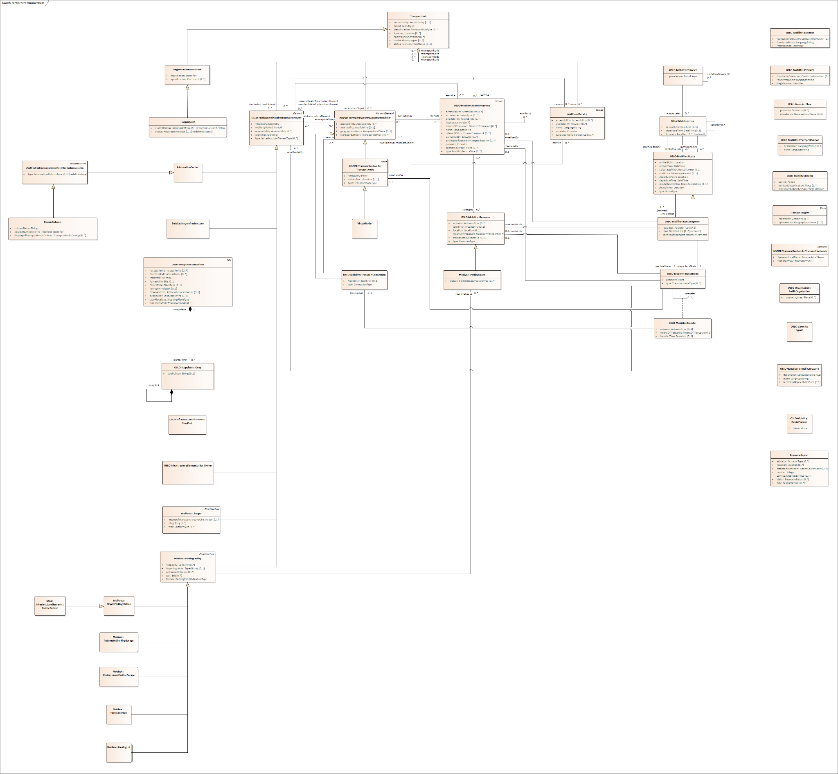
Classes

Slide 14
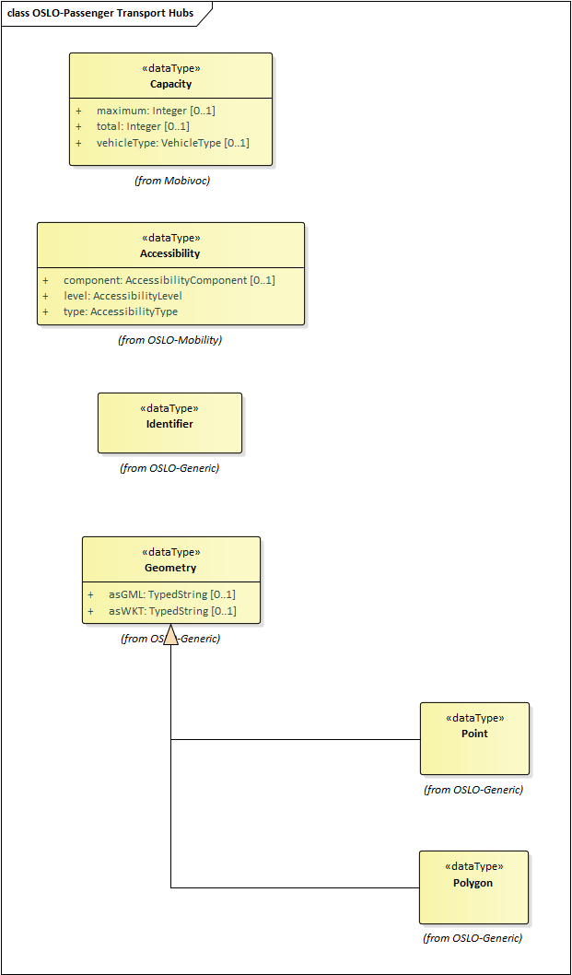
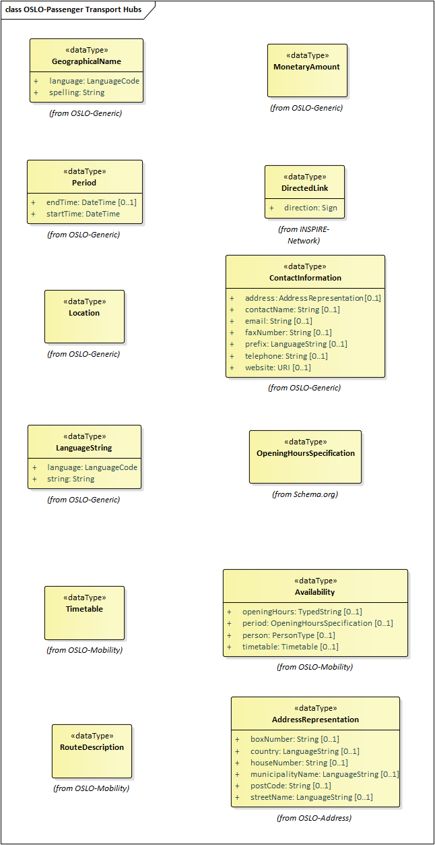
Data types

Slide 15
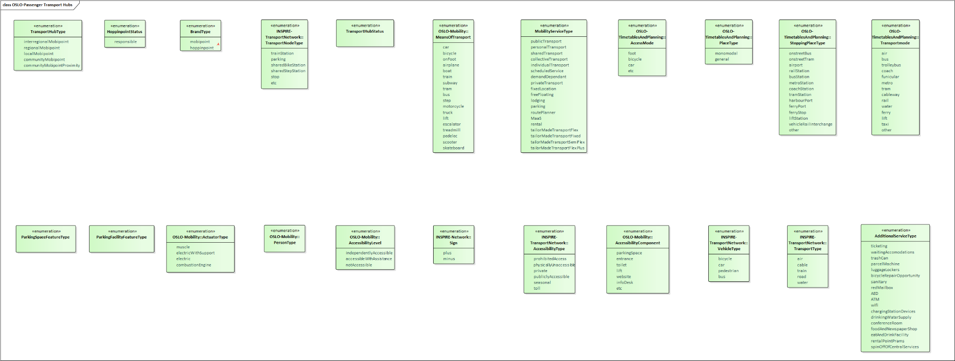
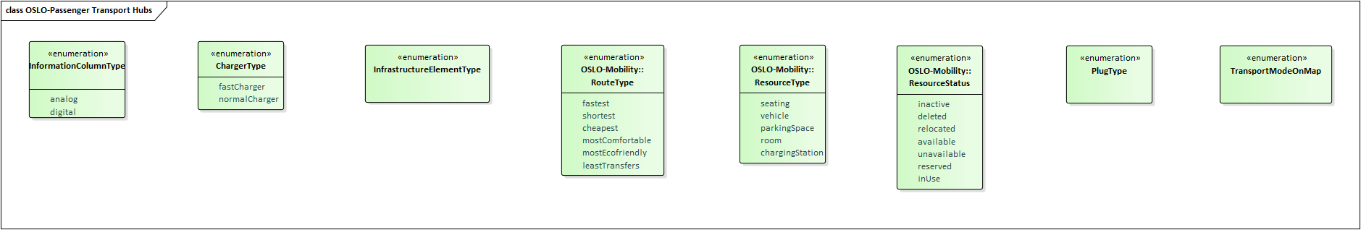
Enumerations

Slide 16
Publication PURL.eu
https://purl.eu/doc/applicationprofile/mobility/passenger-transport-hubs/

Slide 17
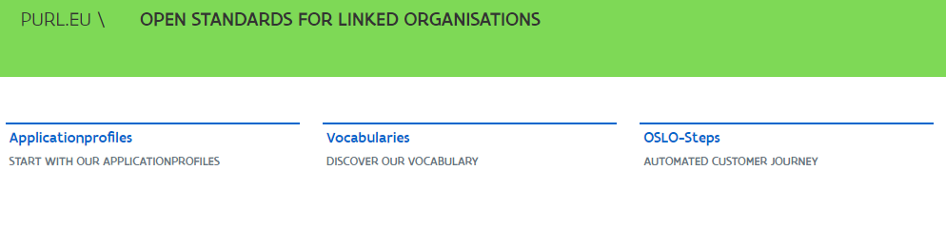
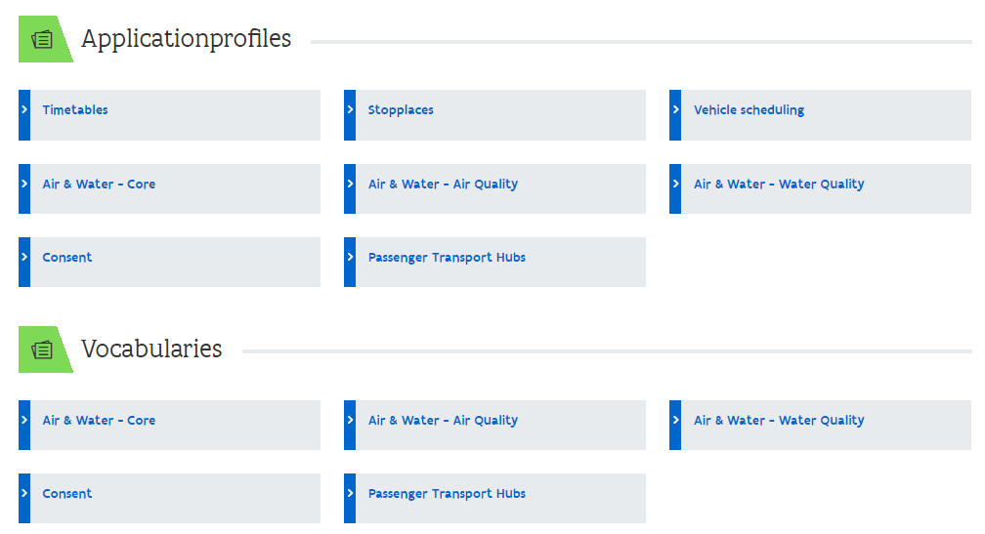
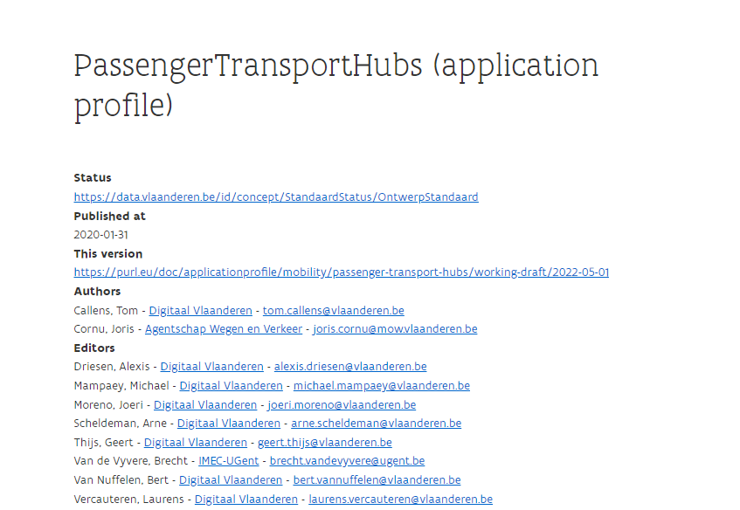
PURL.EU
https://purl.eu/

Slide 18
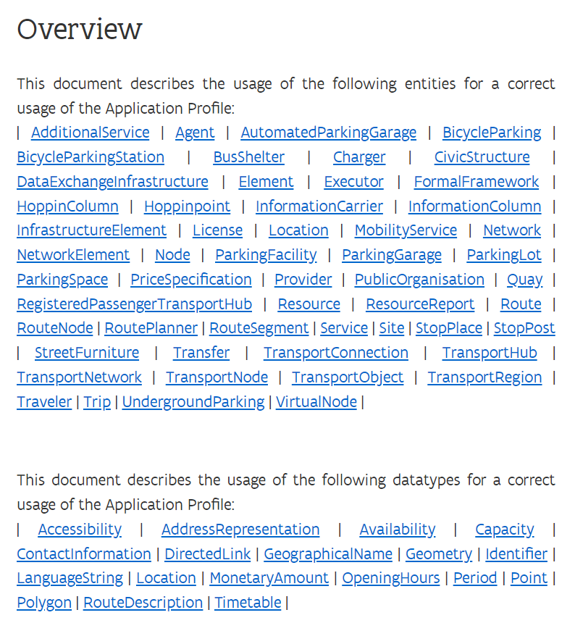
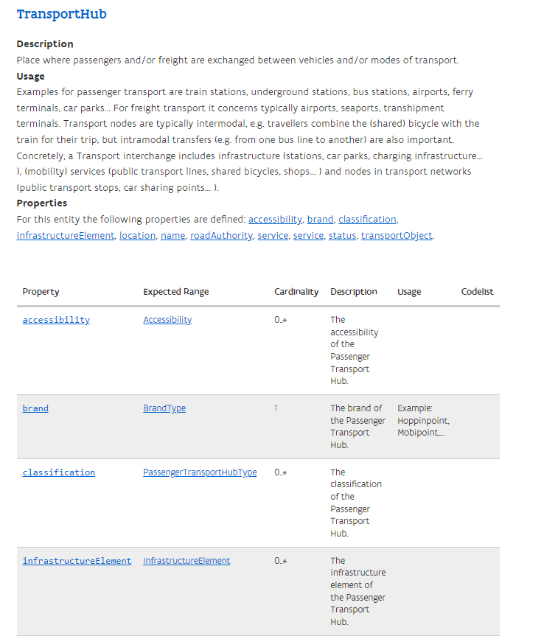
Application profile
https://purl.eu/doc/applicationprofile/mobility/passenger-transport-hubs/

Slide 19
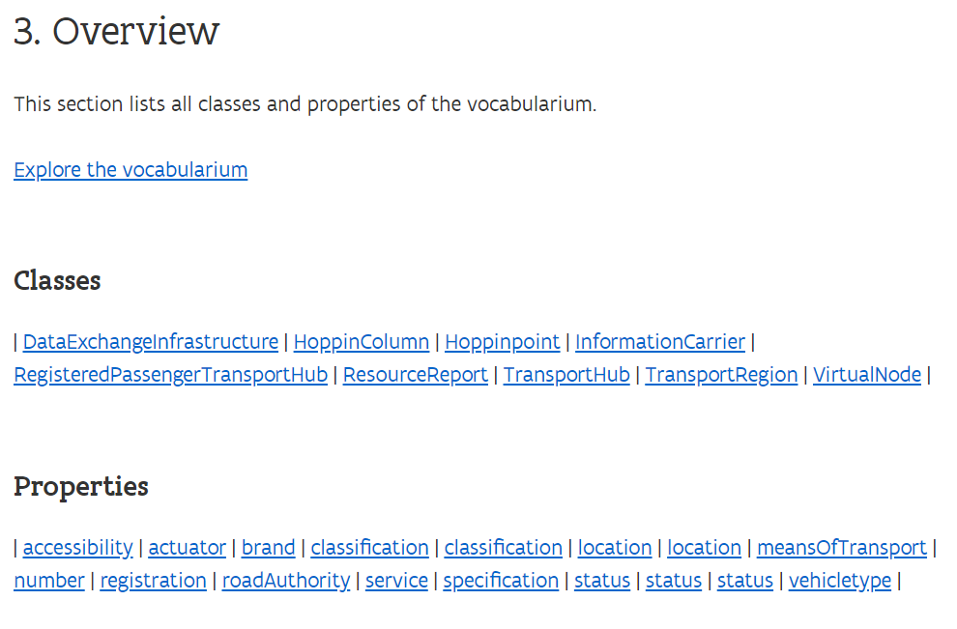
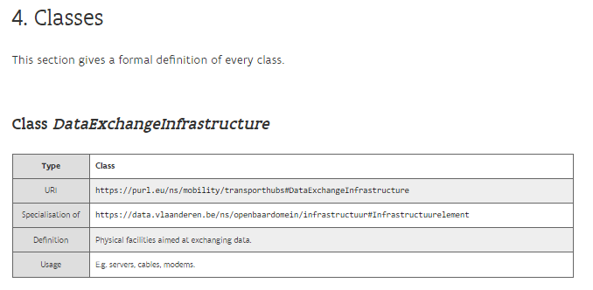
Vocabulary
https://purl.eu/ns/mobility/passenger-transport-hubs/

Slide 20
Registering issues

Slide 21
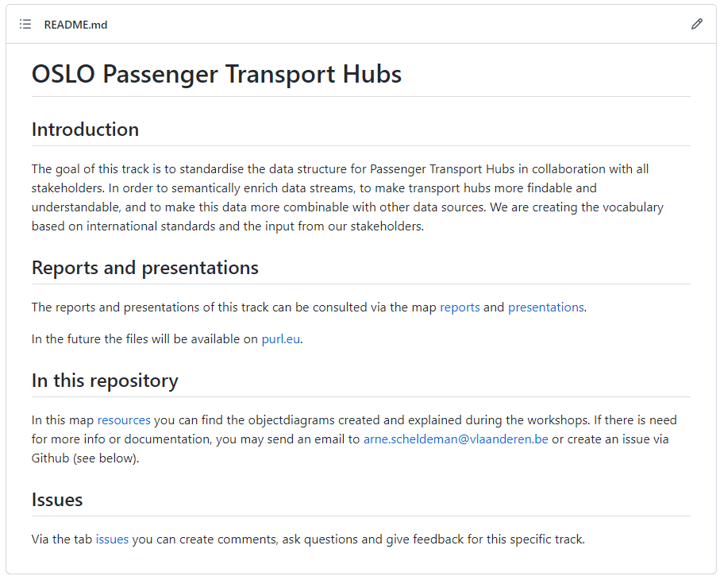

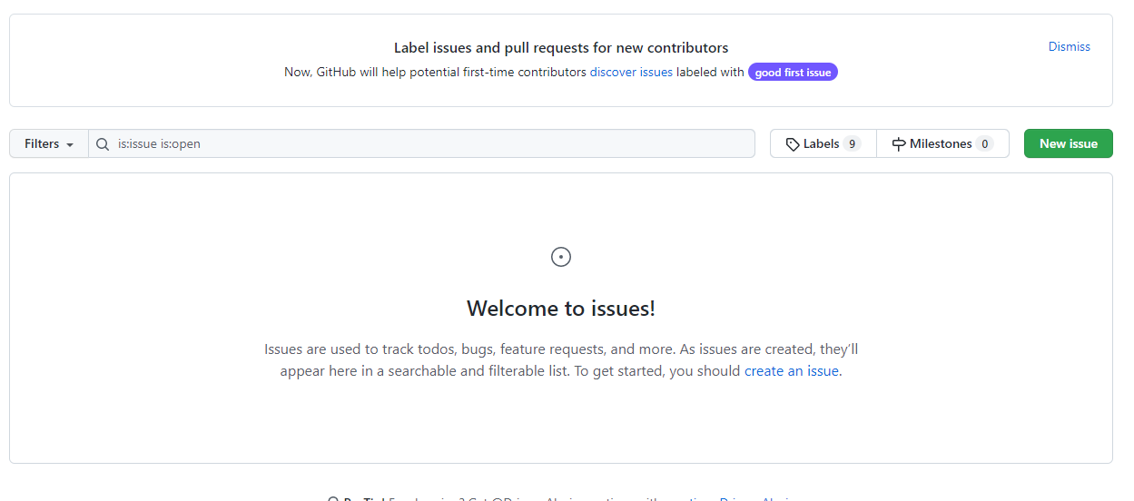
How to register issues?
Register via GitHub page.

Slide 22
Q&A and Next Steps

Slide 23

What do we do…?
Don’t we have to add …?
Can’t we better …?
What about …?
Didn’t we forget …?

Slide 24
Next steps
Process the input.
Distribution of a report from this workshop. Feedback is certainly welcome!
Publication on PURL.eu and start of public review.
Issue gathering via PURL.eu.

Slide 25
Public review
Model is stable
Possibility for PoC development
Based on impact of feedback
Small semantic adjustments
Big semantic adjustments: possibility of additional working group

Slide 26
Planning
Public review within approximately two weeks.
Today
Business workshop
Thematic workshop 2
End public review period
2022
April
May
June
July
August
September
October
November
December
Thematic workshop 1
Start public review period
Implementation of the draft specification

Slide 27


Feedback & cooperation
Feedback/input can be provided via GitHub:
https://github.com/Informatievlaanderen/OSLOthema-passengerTransportHubs
Through the creation of issues
Feedback can be provided by e-mail to the following persons:
digitaal.vlaanderen@digitaal.vlaanderen.be
laurens.vercauteren@vlaanderen.be
arne.scheldeman@vlaanderen.be
alexis.driesen@vlaanderen.be

Slide 28
Thank you!

Slide 29
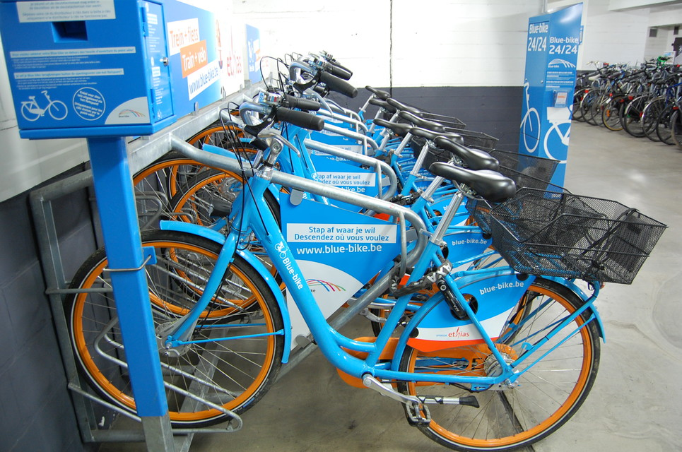

LDES data-example
Assumption: we are going to synchronise our replica-database
E.g. by polling the EventStream
Here: the Evenstream of OSLO PTH → Resource
To ensure that it is up-to-date (in order that we always know the correct number of available bikes in a train station, e.g. Blue-bikes in this example).

Slide 30
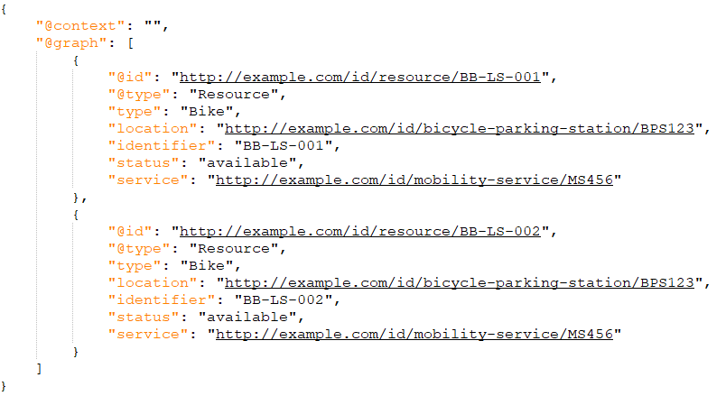
LDES data-example
Let’s assume that our replica of the Resources database looks like this at 9am.
Two bikes are available at that moment:
Bike BB-LS-001
Bike BB-LS-002
They are in BicycleParkingStation BPS123 (in Leuven station)
And provided by MobilityService MS456 (Blue-bike service)
Notes:
Uri's zitten meegenomen in @context wat hierin niet uitgemodelleerd is. Vb bij @typeUri's zitten meegenomen in @context wat hierin niet uitgemodelleerd is. Vb bij @type

Slide 31
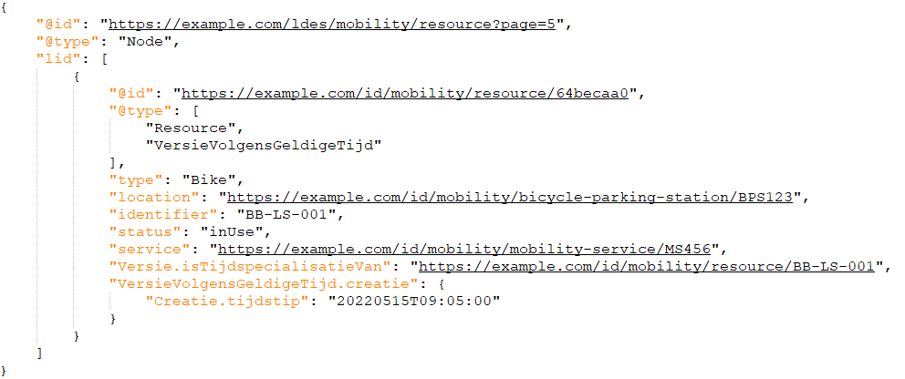
LDES data-example: Evenstream, Node
When polling the PTH:Resource Eventstream e.g. at 9:15am we see a new version for bike BB-LS-001
The status of the bike changed from “available” to “inUse” at 9:05am.
The Evenstream (https://example.com/ldes/mobility/resource) presents updates page by page.
Here the update was found on page 5 (the pages are called Nodes in LDES)
REMARK: For illustrative reasons the page presents only one update, there could have been a lot more.
2
1
1
2

Slide 32
LDES data-example: Version
Version is modelled according to OSLO-Generics (based on the PROV-ontology).
The update is of type VersionInValidtime (i.e. the Version of this Resource in real- time).
It remains a Resource, while the update is a Version and a Resource at the same time. Thus, it has attributes of both.
It has a version id, here implemented as a GUID.
Being a Version, it inherited the attributes of this class, like a pointer to the original Object and the time the Version was created (which is 9:05am).
1
2
1
2
3
3

Slide 33
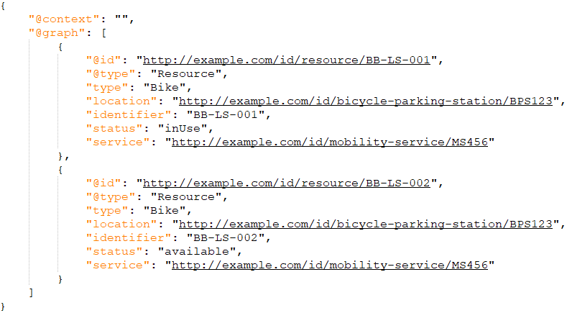
LDES data-example: Processing
After processing the update, we see in our replica that only bike BB-LS-002 is still available
A count for BicycleParkingStation BPS123 (in Leuven station) would show that the number of available bikes is now 1

